Slide 1


GROUNDWORK
Where to open. What it costs. How to pay for it.
Location Intelligence & Financing for Small Business
Bridging site selection, startup cost modeling, and Canadian government financing matching.
THE GROUND CREW

Slide 2





TARGET AUDIENCE — USER PERSONAS & ARCHETYPES
Tailored Value Propositions for Primary Stakeholders
FIRST TIME FOUNDER
NEWCOMER ENTREPRENEUR
JESSICA MARTINS
32 | Aspiring Café Owner (Toronto, ON)
AHMED KHAN
38| Bakery Owner (Scarborough, ON)
Background: 8 years in marketing. Has $60k personal savings but lacks spatial data tools and commercial loan experience.
Background: Ran successful bakeries abroad for 10+ years. Arrived in Canada 18 months ago with strong operations skill set.
Core Pain Point: Fear of committing to a 5-year lease in a saturated neighborhood without knowing true foot traffic or demand.
Core Pain Point: Overwhelmed by Canadian banking standards, municipal permits, and hidden government grant eligibility rules.
Groundwork Value: Neighborhood demand scores + clear loan checklist.
Groundwork Value: Automated grant matching + lender report output.
Personas are composites built from published Statistics Canada survey data, not interviews. Portraits are illustrations.

Slide 3

THE CORE CHALLENGE — DUAL MARKET BARRIERS
Location Blindspots & The Capital Access Gap
PROBLEM 01
PROBLEM 02
Location Risk: Chosen Without Evidence
Capital Gap: Information & Readiness
Independent owners pick units based on advertised rent or foot traffic without line-of-sight into local competition or neighborhood demographics.
Small businesses underutilize financing not due to capital scarcity, but because of awareness gaps and preparation friction before launch.
68.0% / 48.2%
97% Approval Rate
5-yr and 10-yr SME survival rate in Canada (ISED Statistics).
Debt financing approval rate for SMEs that formally apply.
2.4% / +7.5%
Only 7% Request Govt Debt
GTA retail vacancy & H1 2026 rise in food-service insolvencies.
Constraint is information & capital stack assembly, not approval.

Slide 4

CUSTOMER JOURNEY MAP & WORKFLOWS
End-to-End User Experience & Value Touchpoints
STAGE 01
STAGE 02
STAGE 03
STAGE 04 — CORE
STAGE 05
STAGE 06
Opportunity Trigger
Spatial Scanning
Site Verification
Cost & Capital Match
Pitch Export
Launch & Scaling
Entrepreneur identifies concept & begins searching GTA retail units.
Explores citywide map displaying 140 neighborhood density scores.
Audits local competition, foot traffic proxies, and target demographics.
Builds operating cost model & matches federal/provincial programs.
Exports verified loan pack & site analysis for lenders and advisors.
Receives ongoing intake window alerts for post-launch grants.
Excited
Focused
Prepared
Informed
Supported
Scattered
Clear on options
NEUTRAL
Unsure
Frightened
Overwhelmed
Anxious
Touchpoint: Web / SBEC
Touchpoint: Interactive Map
Touchpoint: Site Scorecard
Touchpoint: Financing Matcher
Touchpoint: PDF / Plan Pack
Touchpoint: Grant Alerts
EMOTIONAL STATE
With Groundwork
Without
Illustrative arc for the constructed persona

Slide 5

COMPETITIVE MATRIX
Strategic Differentiation vs Enterprise GIS
UNCONTESTED SPACE
Established Competitors
Groundwork Platform
Esri ArcGIS BA, Environics, Sitewise, SiteZeus
Prototyped Core Engine
Demographic & drive-time mapping
Federal, provincial & municipal program matching
Foot-traffic & spending segmentation
Capital stack assembled against stated needs
Zero small business financing matching
Source URL & last-verified date on every rule
Require sales calls & $10k+ enterprise contracts
$99.99 transparent single-plan pricing

Slide 6

COMMERCIAL MODEL
Price on the Page. No Sales Call Required.
SINGLE-SITE PLAN
PLANNING SUBSCRIPTION
$99.99 / one-time
$249 / month
For first-time owners opening a single location.
For multi-site operators & active advisors.
Full scoring for one neighbourhood
Unlimited neighbourhoods & scenarios
Complete line-item cost model
Side-by-side site comparison
Financing shortlist & capital stack
Saved shortlists & intake-window alerts
30 days to revise and re-export
Prior $99.99 purchase credited to Month 1

Slide 7

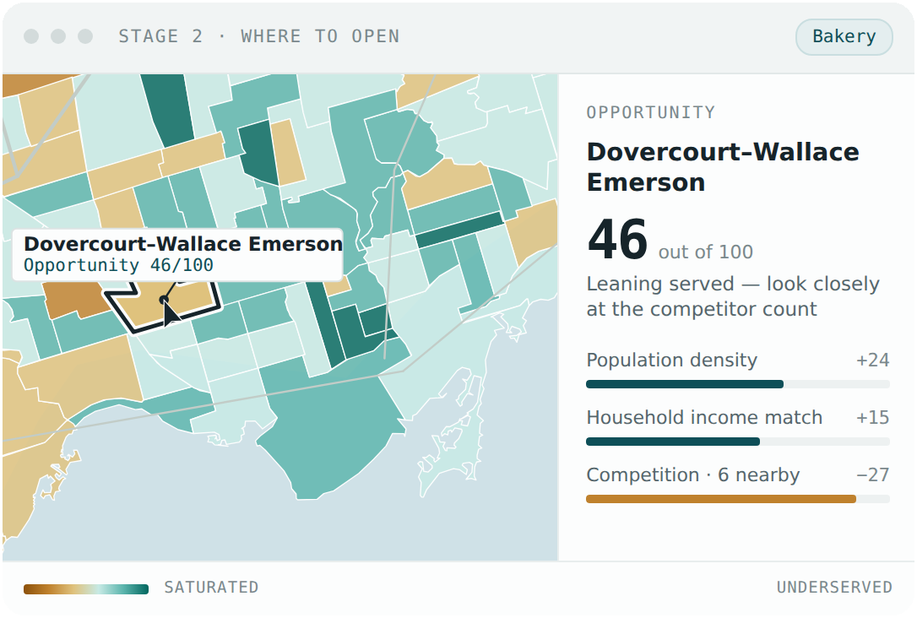
LIVE DEMO
Let's see it work.
One owner, one evening, five stages. Watch how a single choice of business type drives the map, the budget and the funding list.
01
Profile
Business type, capital and experience. Asked once.
02
Where
140 Toronto neighbourhoods scored, with the reasons shown.
03
What it costs
A line-item budget, each line showing its basis.
04
How to pay
Groundwork prototype, Stage 2: where to open
Federal, Ontario and City programs checked for eligibility.
WATCH FOR the funding shortfall, stated plainly.
05
The plan
Everything assembled into the document a lender asks for.
Notes:
Transition: That is the problem and the model. Rather than describe the product, we will run it. We will go through the five stages in one sitting, starting from a profile and ending with a plan a lender can read.

Slide 8









THE GROUND CREW
Thank you. Questions?
Scan a code to connect with us on LinkedIn.
Jesutofunmi Oluwadare
Bijila Margaret
Soudeh Soufi
Sarra Drine
Data Steward, AI Governance Specialist
Java Developer
Business Analyst, Strategic Transformation
Full Stack Engineer
LINKEDIN
LINKEDIN
LINKEDIN
LINKEDIN

